Slide 1
Servo with fingerprint sensor
Nugroho Budi Prasetyo (11021922775)

Slide 2

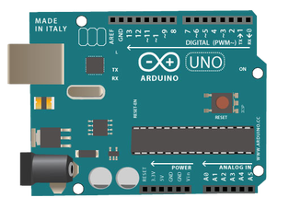

Slide 3

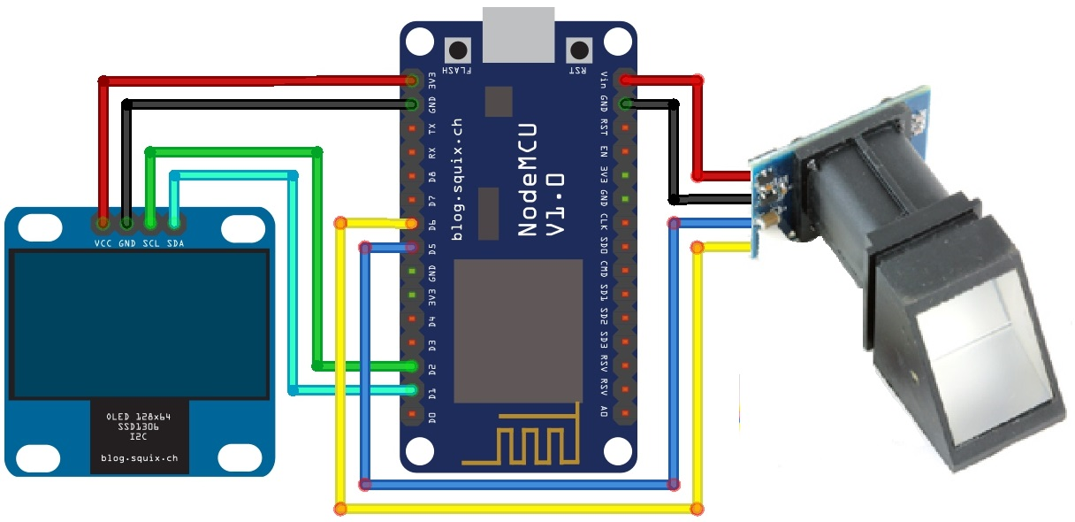

Slide 4
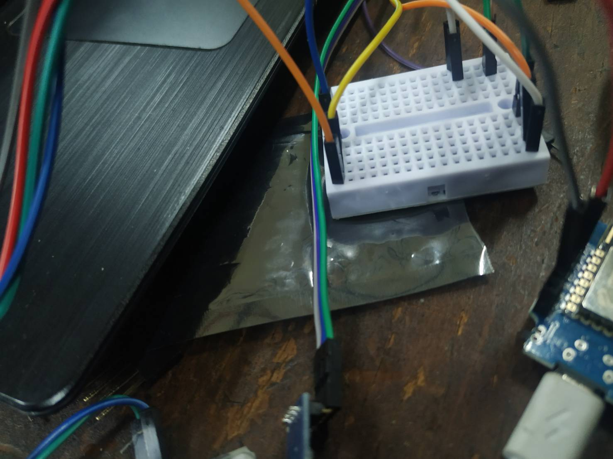

Slide 5
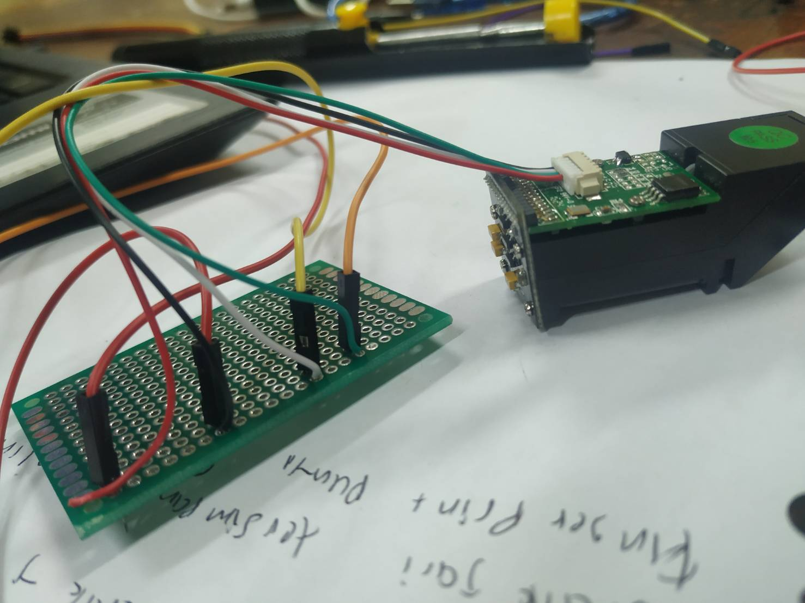

Slide 6
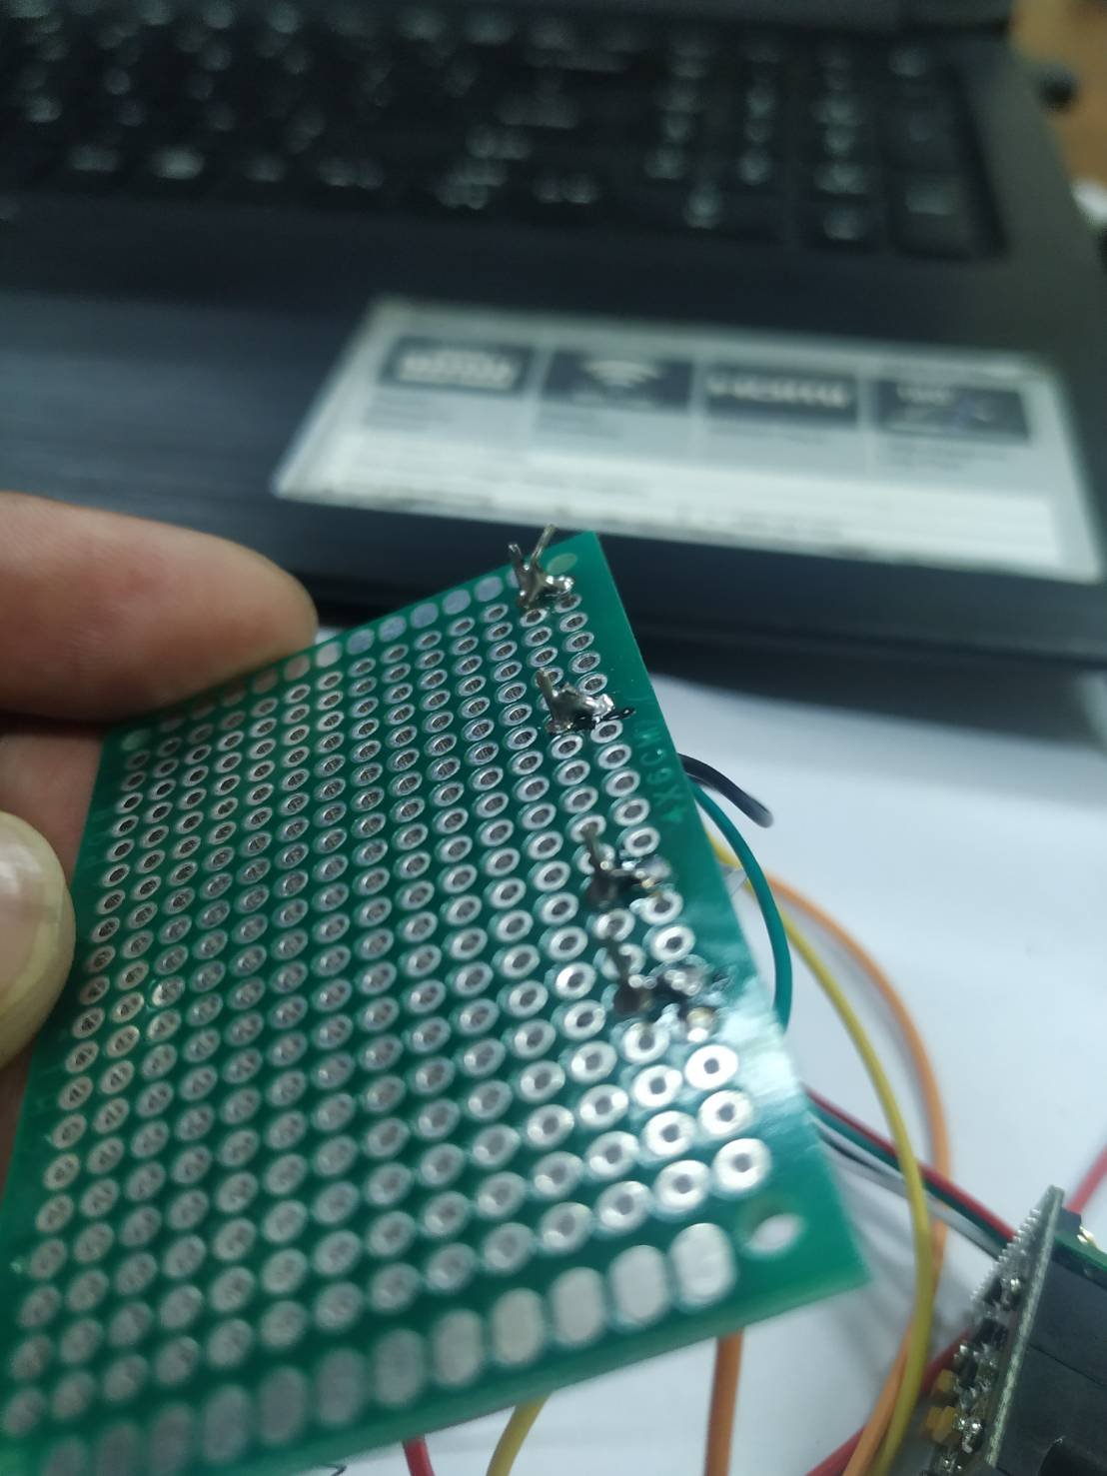

Slide 7
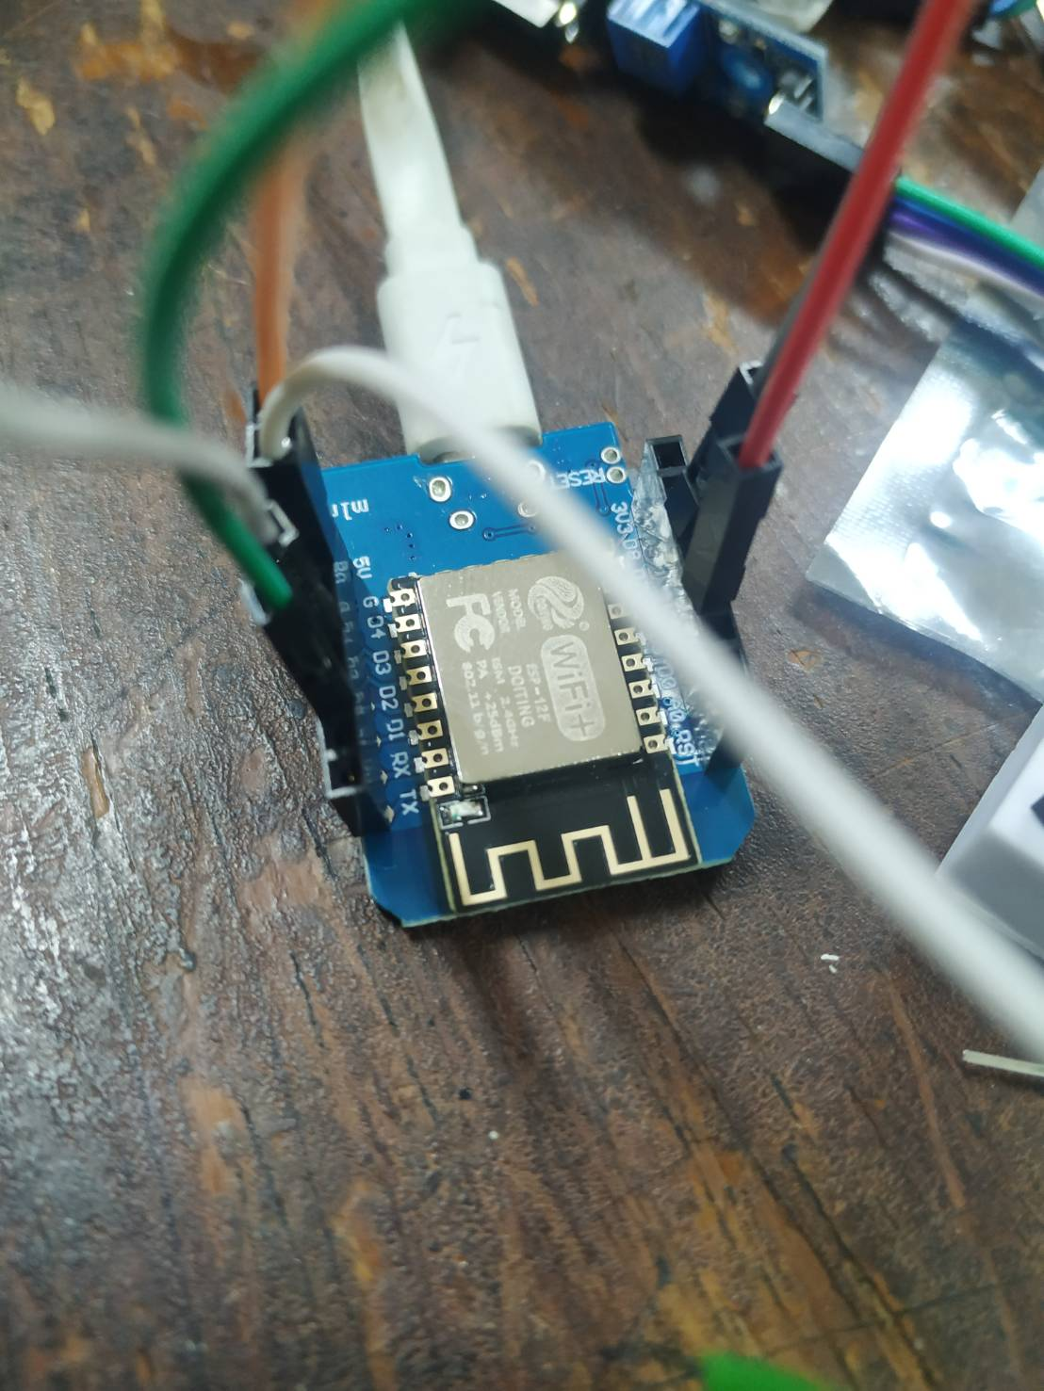

Slide 8
Penjelasan source code

Slide 9
Terimakasih

